Slide 1
Control Structures in C
A control structure is like a block of programming that analyses variables and chooses a direction in which to go based on given parameters.
The term flow control details the direction the program takes (which way program control "flows"). Hence it is the basic decision-making process in computing. It is a prediction.
Types of Control structures:
Sequence structure
Selection structure
Repetitive structure

Slide 2
Control structures
Sequence Structure :
It is in the form of Assignment statement
Selection structure:
* Decision Making (if …else)
* Switch… case Statement
Repetitive structure:
* Loops (for loop, do while)
* Break and Continue Statement
* goto and label Statement

Slide 3
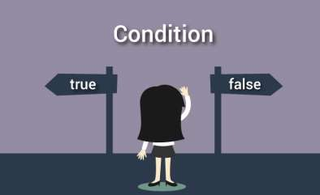
Decision Making
◆ Decision making is used to specify the order in which statements are executed.
Decision making in a C program using:
if statement
if…else statement
if…else if…else statement
nested if...else statement
Switch case Statement

Slide 4
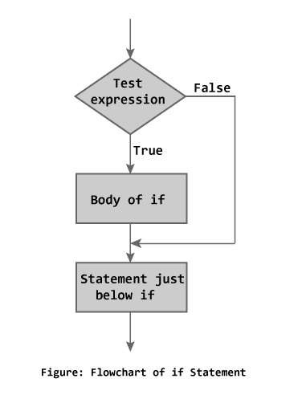
Simple if statement
if (testExpression)
{
// statements
}

Slide 5
Example: if statement
Program:
#include <stdio.h> int main()
{ int number;
printf("Enter an integer: "); scanf("%d", &number);
// Test expression is true if number is less than 0 if (number < 0) {
} printf("You entered %d.\n", number);
printf("The if statement is easy.");
} return 0;

Slide 6
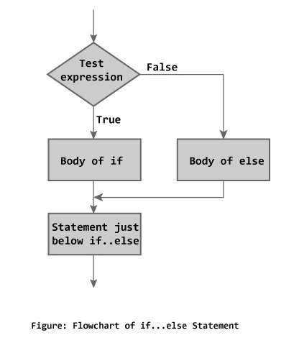
if...else statement
◆ The if...else statement executes the code if the given test expression is true, otherwise it executes else statements.
Syntax of if...else
if (testExpression)
{
// codes inside the body of if
}
else
{
// codes inside the body of else
}

Slide 7
Example: if...else statement
// Program to check whether an integer entered by the user is odd or even
#include <stdio.h>
int main()
{
int number;
printf("Enter an integer: "); scanf("%d",&number);
// True if remainder is 0 if( number%2 == 0 )
printf("%d is an even integer.",number); else
printf("%d is an odd integer.",number); return 0;
}

Slide 8
if...else if....else Statement
◆ The if...else statement executes two different codes depending upon whether the test expression is true or false. Sometimes, a choice has to be made from more than 2 possibilities.
◆ The if...else if…else statement allows you to check for multiple test expressions and execute different codes for more than two conditions.

Slide 9
Syntax of if...else if....else statement.
if (testExpression1) {
// statements to be executed if testExpression1 is true
} else if(testExpression2) {
// statements to be executed if testExpression1 is false and testExpression2 is true
} else if (testExpression 3) {
// statements to be executed if testExpression1 and testExpression2 is false and testExpression3 is true
} else {
// statements to be executed if all test expressions are false
}

Slide 10
Example: if...else if....else statement
// Program to relate two integers //checks if number1 is greater than
using =, > or < #include <stdio.h> int main(){
int number1, number2; printf("Enter two integers: ");
number2.
else if (number1 > number2) {
printf("Result: %d > %d",
number1, number2);
}
// if both test expression is false else {
scanf("%d %d", &number1,
&number2);
//checks if two integers are
printf("Result: %d < %d",
equal.
number1, number2);
if(number1 == number2){
}
printf("Result: %d = %d“,
return 0;
number1,number2);
}
}

Slide 11
Nested if else statement
◆ Nested if else statement is same like if else statement, where new block of if else statement is defined in existing if or else block statement.
◆ It is used when user want to check more than one conditions at a time.

Slide 12
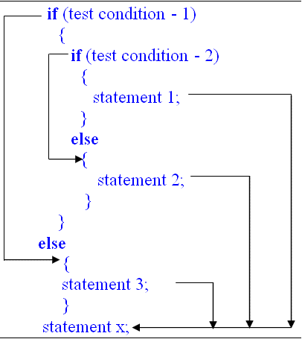
Syntax of Nested If else Statement
if(condition is true){
if(condition is true){
statement;
}else{
statement;
}
}else{
statement;
}

Slide 13
Example of Nested if else Statement
#include <stdio.h> void main(){
char username;
int password;
printf("Username:"); scanf("%c",&username); printf("Password:"); scanf("%d",&password);
if(username=='a'){
if(password==12345){
printf("Login successful");
printf("Password is incorrect, Try again.");
}else{
}else{ }
} printf("Username is incorrect, Try again.");
}

Slide 14
Loops
◆ Loops are used in programming to repeat a specific block until some condition is met.
In general there are two kinds of loops,
Entry control loop
Exit control loop
◆ There are three loops in C programming:
for loop
while loop
do...while loop
Nested loops

Slide 15
for Loop
It is the simplest, fixed and entry controlled loop.
It has two segments, one is control statement and other one is body of the loop.
Fixed number of iteration is know in advance.
Syntax:
for (initializationStatement; testExpression; updateStatement)
{
// codes
}

Slide 16
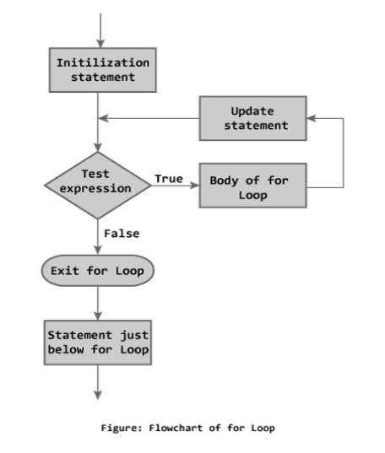
for loop Flowchart

Slide 17
Example: for loop
// Program to calculate the sum of
first n natural numbers
// Positive integers 1,2,3...n are known as natural numbers
#include <stdio.h> int main(){
int n, count, sum = 0;
printf("Enter a positive integer: ");
scanf("%d", &n);
// for loop terminates when n is less
than count
for(count = 1; count <= n; ++count)
{
sum += count;
}
printf("Sum = %d", sum); return 0;
}

Slide 18
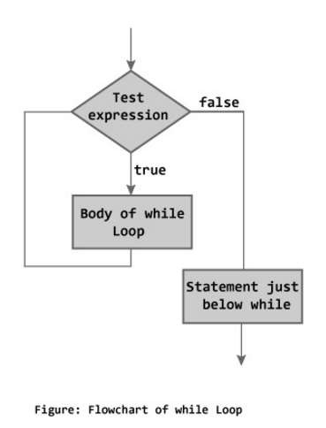
while loop
Syntax:
while (testExpression)
{
//codes
}

Slide 19
Example: while loop
/ Program to find factorial of
a number
// For a positive integer n, factorial = 1*2*3...n
#include <stdio.h>
int main(){
int number; long factorial;
printf("Enter an integer: "); scanf("%d",&number); factorial = 1;
_{th} // loop terminates when number is less an or equal to 0
while (number > 0) {
// factorial = factorial*number; factorial *= number;
--number;
}
printf("Factorial= %lld", factorial); return 0;
}

Slide 20
do...while loop
◆ The do..while loop is similar to the while loop with a major difference.
◆ The body of do...while loop is executed once, before checking the test expression.
◆ The do...while loop is executed at least once.

Slide 21
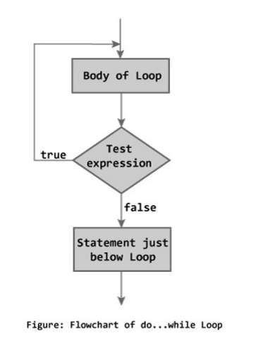
do...while loop
Syntax :
do
{
// codes
}
while (testExpression);

Slide 22
Example: do...while loop
// Program to add numbers until user enters zero #include <stdio.h>
int main() {
double number, sum = 0;
// loop body is executed at least once
do{
printf("Enter a number: "); scanf("%lf", &number); sum += number;
}while(number != 0.0); printf("Sum = %.2lf",sum); return 0;
}

Slide 23
Nested loops
◆ C programming allows to use one loop inside another
loop.
Syntax :
for ( init; condition; increment ) {
for ( init; condition; increment ) { statement(s);
}
statement(s);
}

Slide 24
Nested loops
◆ Syntax while loop
while(condition) {
while(condition) { statement(s);
}
statement(s);
}

Slide 25
Nested loops
◆ Syntax do while loop
do {
statement(s); do {
statement(s);
}while( condition );
}while( condition );

Slide 26
Example : Nested Loops
#include <stdio.h>
int main()
{ int n, c, k;
printf("Enter number of rows\n"); scanf("%d",&n);
for ( c = 1 ; c <= n ; c++ ){
for( k = 1 ; k <= c ; k++ ) printf("*");
printf("\n");
}
} return 0;

Slide 27
Break Statement
◆ The break statement terminates the loop immediately when it is encountered.
◆ The break statement is used with decision making statement such as if...else.
◆ Syntax of break statement
break;

Slide 28
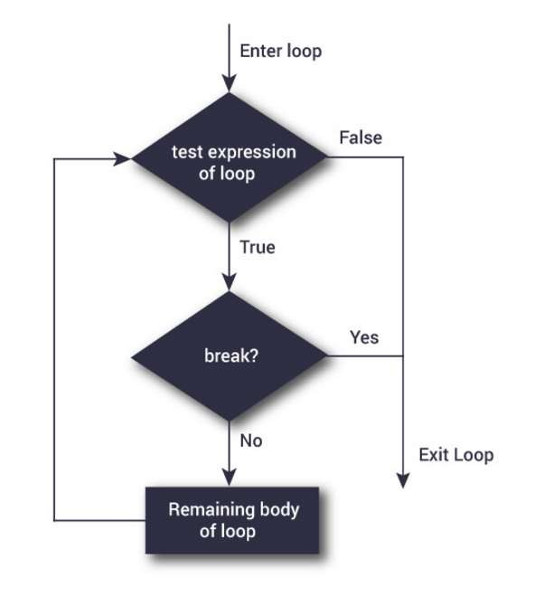
Flowchart Of Break Statement

Slide 29
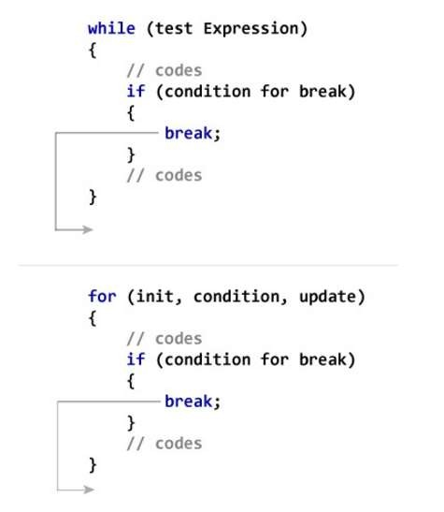
How break statement works?

Slide 30
Example: break statement
// Program to calculate the sum of maximum of 10 numbers
// If user enters negative
enters positive number # include <stdio.h>
int main() {
int i;
double number, sum = 0.0; for(i=1; i <= 10; ++i) {
printf("Enter a n%d: ",i); scanf("%lf",&number);
number, loop is terminated if(number < 0.0) {
break;
}
// sum = sum + number; sum += number;
}
printf("Sum = %.2lf",sum); return 0;
}
// Calculates sum until user

Slide 31
Continue Statement
◆ The continue statement skips some statements inside the loop.
◆ The continue statement is used with decision making statement such as if...else.
◆ Syntax of continue Statement
◆ continue;

Slide 32
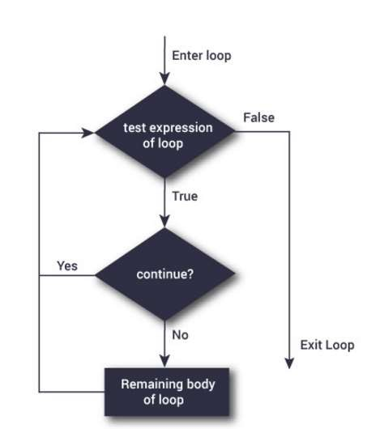
Flowchart of Continue Statement

Slide 33
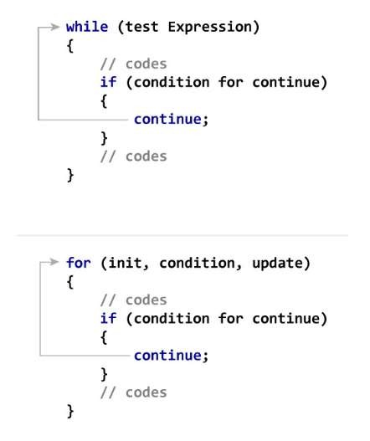
How Continue Statement Works?

Slide 34
Example: continue statement
// Program to calculate sum of
// If user enters negative
maximum of 10 numbers
number, loop is terminated if(number < 0.0) {
continue;
// Negative numbers are skipped
from calculation
# include <stdio.h> int main(){
int i;
double number, sum = 0.0; for(i=1; i <= 10; ++i) {
printf("Enter a n%d: ",i); scanf("%lf",&number);
}
// sum = sum + number;
sum += number;
}
printf("Sum = %.2lf",sum); return 0;
}

Slide 35

Switch...Case Statement
◆ The if...else if…else statement allows you to execute a block code among many alternatives. If you are checking on the value of a single variable in if...else if…else statement, it is better to use switch statement.
◆ The switch statement is often faster than nested if...else (not always). Also, the syntax of switch statement is cleaner and easy to understand.

Slide 36
Syntax of switch...case
switch (n){
case constant1:
// code to be executed if n is equal to constant1; break;
case constant2:
// code to be executed if n is equal to constant2; break;
.
.
.
default:
// code to be executed if n doesn't match any constant
}

Slide 37
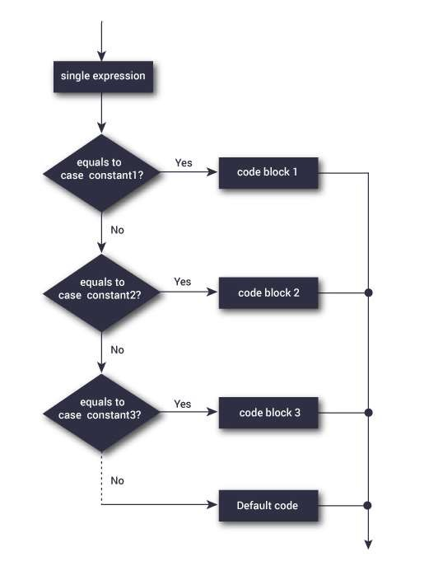
Switch Statement Flowchart

Slide 38
Example: switch Statement
// Program to create a simple calculator
// Performs addition, subtraction, multiplication or division
depending the input from user
# include <stdio.h> int main() {
char operator;
double firstNumber,secondNumber; printf("Enter an operator (+, -, *,): ");
scanf("%c", &operator); printf("Enter two operands: ");
scanf("%lf %lf",&firstNumber, &secondNumber);

Slide 39
switch(operator) {
case '+':
printf("%.1lf + %.1lf = %.1lf",firstNumber, secondNumber, firstNumber+secondNumber); break;
case '-':
printf("%.1lf - %.1lf = %.1lf",firstNumber, secondNumber, firstNumber-secondNumber); break;
case '*':
printf("%.1lf * %.1lf = %.1lf",firstNumber, secondNumber, firstNumber*secondNumber); break;
case '/':
printf("%.1lf / %.1lf = %.1lf",firstNumber, secondNumber, firstNumber/firstNumber); break;
// operator is doesn't match any case constant (+, -, *, /)
default:
printf("Error! operator is not correct");
}
return 0; }

Slide 40

goto Statement
◆ The goto statement is used to alter the normal sequence of a C program.
Syntax:
goto label;
... .. ...
... .. ...
... .. ...
label: statement;

Slide 41
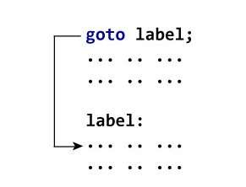
What is Label?
◆ The label is an identifier. When goto statement is encountered, control of the program jumps to label: and starts executing the code.

Slide 42
Example: goto Statement
// Program to calculate the sum and average of maximum of 5
numbers
previously entered positive number is displayed
# include <stdio.h> int main(){
const int maxInput = 5; int i;
double number, average, sum=0.0;
for(i=1; i<=maxInput; ++i){ printf("%d. Enter a number: ", i); scanf("%lf",&number);
// If user enters negative number, the sum and average of

Slide 43
Example: goto Statement
_{ju} // If user enters negative number, flow of program moves to label
mp
if(number < 0.0) goto jump;
sum += number; // sum = sum+number;
}
jump:
average=sum/(i-1);
printf("Sum = %.2f\n", sum); printf("Average = %.2f", average); return 0;
}

Slide 44
Any Queries?

